Slide 1
Intuitive Control Algorithm Development of 4WIS/4WID Using a SpaceMouse
Kent School Guild Presentation
Tyler (Taewook) Kim ’20
2019.04.16🎗️
Notes:
Hello everyone, and thank you so much for being here.
My name is Tyler Kim, and today I would like to present my guild paper I have been working since last year with Dr. Nadire , “Intuitive Control Algorithm Development of 4WIS/4WID Using a Spacemouse.”
Before I began, I would like to thank Mr. Klingebiel and the Kent school guild for giving such a valuable opportunity. It is truly exciting to share what I have studied on with others.

Slide 2
4WIS/4WID
4 Wheel Independent Steering/Driving:
a steering system for a four-wheeled vehicle that allows for separate speed and direction controls for each wheel.
Notes:
So the title says development of control algorithm for 4WIS/4WID?
let's go over some key terms in my project. So what is this?
4WIS/4WID is a type of omnidirectional steering system that stands for Four wheel independent steering and driving.
In engineering, omnidirectional steering system is defined as a type of steering system that allows vehicle to go in any direction.
And this specific steering system allows us to control speed and direction controls for each wheel.
Basically, unlike conventional vehicles, we can turn and drive each wheel independently which allows vehicle to move in versatile manner along with great maneuverability.

Slide 3
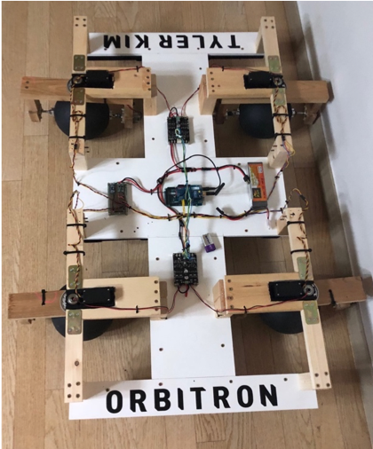
Related Works
Mecanum Wheels
NASA MRV(Modular Robotic Vehicle)
Orbitron + Control Algorithm
Inexpensive and only requires four driving motors to operate.
Capable of versatile motions and high
maneuverability.
Capable of versatile motions and high
maneuverability.
Not ideal for rough terrains.
All wheels have to be in contact with the surface to function properly.
Ineffective controlling mechanism.
Involves a steering wheel and a joystick; Not intuitive for common uses.
Expensive.
Needs eight motors to function:
4 DC motors and 4 Servo motors.
Notes:
And there are already lots of omnidirectional wheels or steering systems that are used in modern industry.
I am going to go over a few related works so it gives you a better understanding of the problem statement.
First one is the Mecanum wheels, which are actually pretty common. Even our pre-engineering center has one for our robotics team.
In fact, I actually brought one here to show you how it looks like.
Mecanum wheels, also known as omni wheels or ilon wheels, consists of a hub with rollers oriented 45 degrees to the axis of rotation. These are widely used in industrial machines such as forklifts.
The advantages these wheels have is that they are fairly inexpensive. They only requires four motors to operate, yet still having the ability to move sideways, forward, or backwards.
If you look at the image above, you can notice that all four wheels are fixed to the vehicle. There’s no need to turn any wheels because we can simply alter the direction of rotation to make this vehicle go crazy.
For example, if front wheels and back wheels rotate in different location, the vehicle can move sideways. Similarily, if left wheels and right wheels rotate in different direction, the vehicle can spin on spot making it easier to go in any direction.
However, as always, there are some drawbacks. Because it’s the different rotating direction that allows the vehicle to move in omni directions, all four wheels always have to touch the surface. This makes it very vulnerable to rough terrains, when it is unlikely that all four wheels will be always in contact with the surface. Additionally, because the wheels consist of rollers, any particles can make them useless. For example, if any dirt or sand gets stuck in between rollers, it will simply immobilize the entire vehicle. This is the reason why they are only being used in indoor warehouses, where the surface is perfectly flat.
Second project I researched about is the NASA MRV, or Modular Robotic Vehicle. NASA worked on this project 2 years ago so they could apply in future mars rovers.
The interesting thing about this project is that they used the same steering mechanism I used in this project. Before I talk about pros and cons for this project, I will show you a short video that shows how beautiful this steering mechanism is capable of.
[SHOW VIDEO]
As you can see, the highlight for NASA MRV is its versatile motions and high maneuverability. While mecanum wheels are like omnidirectional in one dimension, this is the literal definition of omni direction: being able to move in ANY direction.
However, there are also setbacks. Some of you might have noticed how they are controlling the vehicle. They are using a steering wheel along with a joystick for their vehicle.
As they directly mentioned in their article, this way of controlling is not very intuitive and often confuses the users. Therefore, these are not very effective for common uses.
Lastly, here’s my project. Orbitron and the controlling algorithm I developed. This will be the project I’m going to talk about, and it is capable of versatile motions and high maneuverability just like the NASA MRV, but also intuitive to control.
But, it

Slide 4
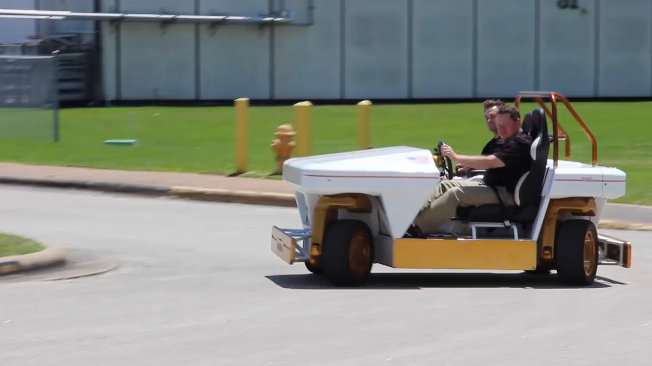
NASA MRV - Video
Notes:
1:27

Slide 5
Related Works
Mecanum Wheels
NASA MRV(Modular Robotic Vehicle)
Orbitron + Control Algorithm
Inexpensive and only requires four driving motors to operate.
Capable of versatile motions and high
maneuverability.
Capable of versatile motions and high
maneuverability.
Not ideal for rough terrains.
All wheels have to be in contact with the surface to function properly.
Ineffective controlling mechanism.
Involves a steering wheel and a joystick; Not intuitive for common uses.
Expensive.
Needs eight motors to function:
4 DC motors and 4 Servo motors.
Notes:
As you can see, the highlight for NASA MRV is its versatile motions and high maneuverability. While mecanum wheels are like omnidirectional in one dimension, this is the literal definition of omni direction: being able to move in ANY direction.
However, there are also setbacks. Some of you might have noticed how they are controlling the vehicle. They are using a steering wheel along with a joystick for their vehicle.
As they directly mentioned in their article, this way of controlling is not very intuitive and often confuses the users. Therefore, these are not very effective for common uses.
Lastly, here’s my project. Orbitron and the controlling algorithm I developed. This will be the project I’m going to talk about, and it is capable of versatile motions and high maneuverability just like the NASA MRV, but also intuitive to control.
The setback for my project would be its price.

Slide 6
Problem Statement
Controlling two parameters (direction and speed) for each wheel results in eight parameters in need of simultaneous control. To our knowledge, neither a keyboard nor a joystick, including a dual joystick, can fully convey the motions that 4WIS/4WID steering mechanism is capable of.
Notes:
This is the problem statement for my research.
For Four wheel independent driving and steering mechanism, Controlling two parameters, direction and speed, for each wheel results in eight parameters in need of simultaneous control.
And really, I have gone through this, and it's really hard.

Slide 7
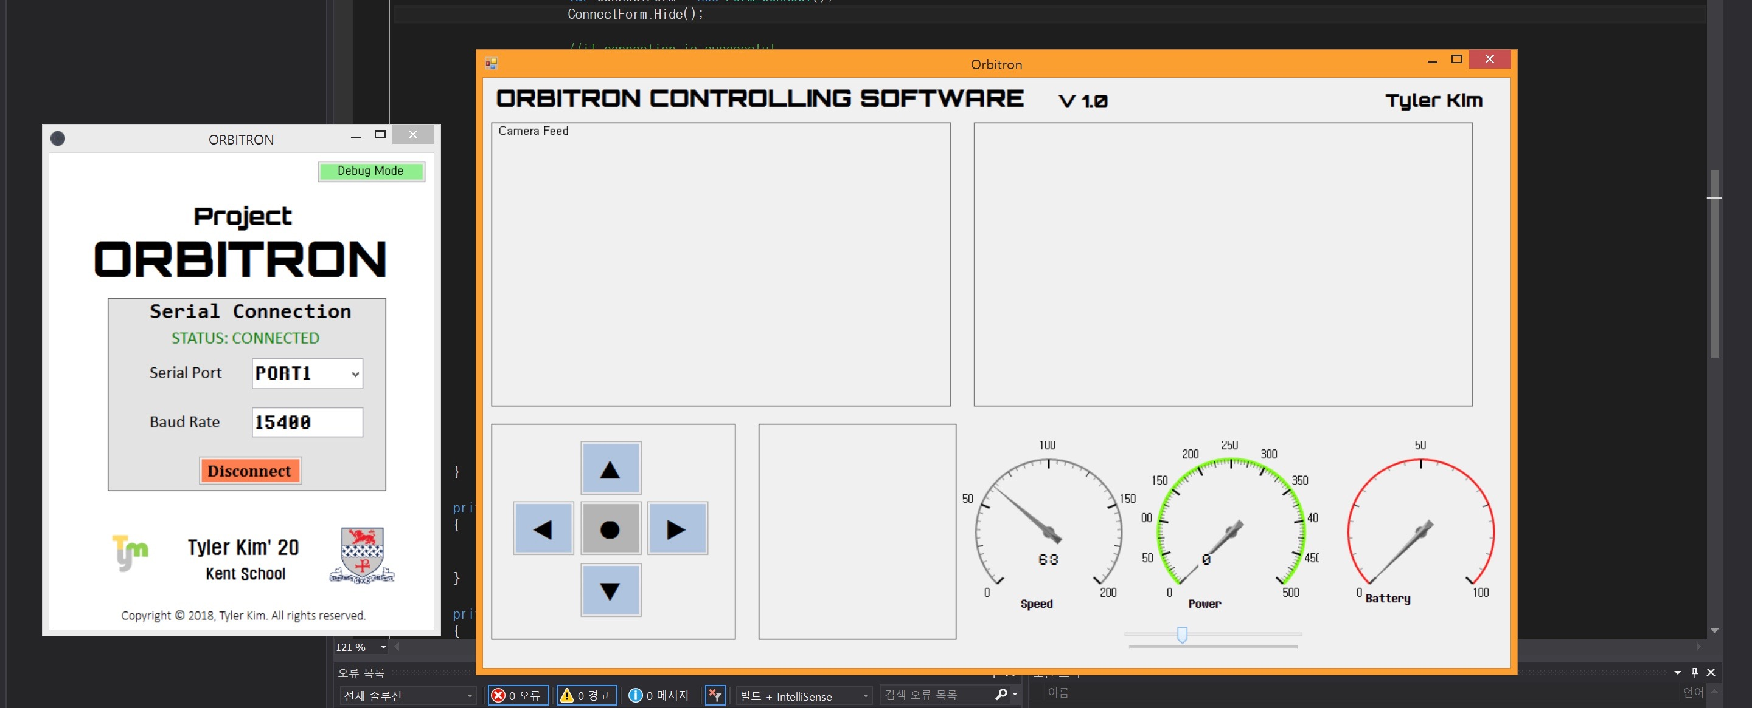
Notes:
In the beginning, when I was building the prototype, I developed a c# window forms application to test my vehicle and make sure all components were working properly.
It had one window that is responsible for connecting the prototype and my laptop, and the other window was used for sending signals to control the vehicle.
I assigned each arrow key for each direction, and the program would send a single character to the vehicle.
And those of you who are experienced in programming, you know how inefficient this is. Basically, I was the master of hard coding at this point.
Fortunately, the program were kind to me and they all worked properly. However, the problem was that it could only move like an ordinary vehicle.
It could move forwards, backwards, and turn, but it was meaningless because it couldn’t take advantage of a specific steering mechanism I used

Slide 8
Problem Statement
Controlling two parameters (direction and speed) for each wheel results in eight parameters in need of simultaneous control. To our knowledge, neither a keyboard nor a joystick, including a dual joystick, can fully convey the motions that 4WIS/4WID steering mechanism is capable of.
Notes:
[SPEAK SLOW]
Now, back to our problem statement.
As you heard about such a hard times I had to go through, neither a keyboard nor a joystick, , can fully convey the motions that 4WIS/4WID is capable of.
This is because it cannot convey the direction, rotation and speed simultaneously. In case of the keyboard, like the program I built, it can send a finite pre- determined direction and speed assigned to each key.
Many keys could be assigned to a variety of direction, rotation and speed combination, approximating continuous control. However, the position of the keys would not be intuitive which will hamper timely response. Using two joysticks could be a solution where one is dedicated to the direction and speed, and the other one is dedicated to rotation. However, this would require two hands and making the control more complex and confusing for the user.

Slide 9
Our Goal
Find a controller that can easily convey the driver’s intention.
Develop an algorithm that understands the driver’s intention and control all four wheels in a cooperative manner.
This development will allow for an intuitive maneuver through spaces that are difficult to navigate in conventional two-wheel steering vehicles.
Notes:
So here’s the objectives for my research.
First, we would need to find a controller that can easily convey the driver’s intention. And we know that keyboard is definitely not the one to use for this project.
Secondly, the algorithm we develop will need to understand the driver’s intention and control all four wheels in a cooperative manner By cooperative manner, I mean that we need to prevent from each wheel conflicting each other.
For example, when one wheel is going forward and other three wheels are going backward, we know we’re not in the best situation here.
If all of these goals are achieved, this will allow for an intuitive maneuver through spaces that are difficult to navigate in conventional two-wheel steering vehicles.

Slide 10
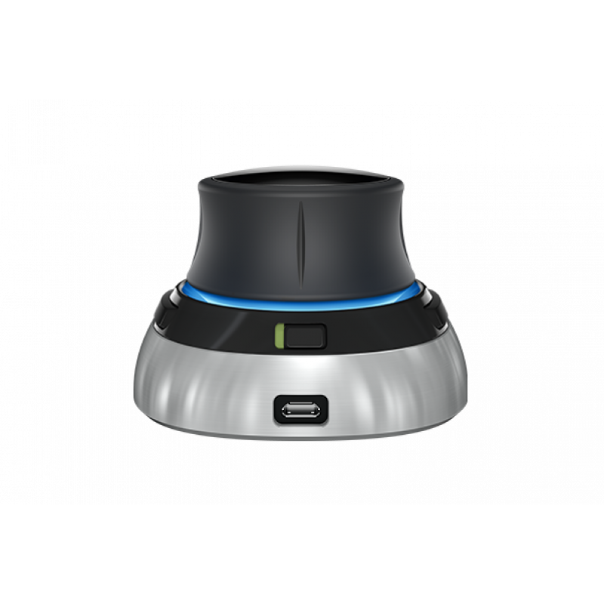
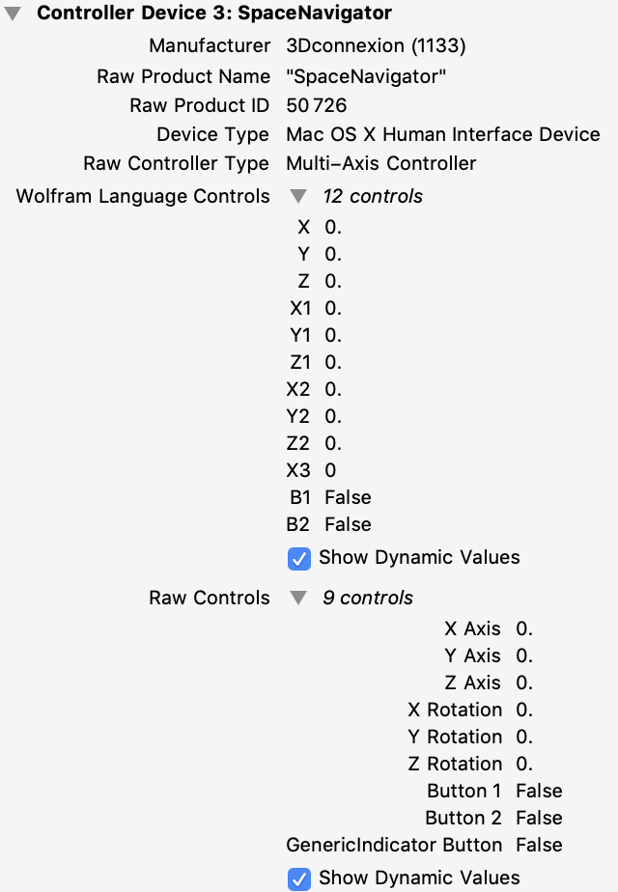
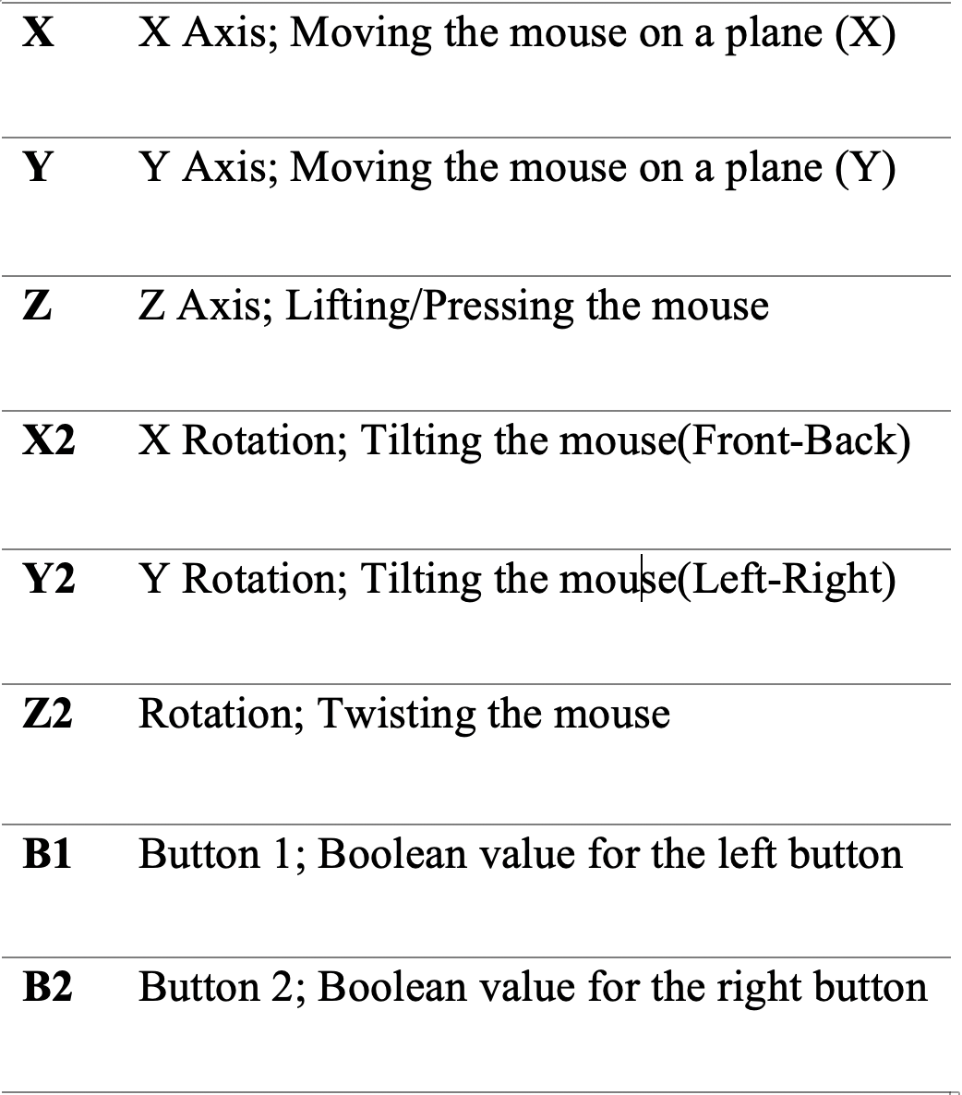
Controller - SpaceMouse
Notes:
And here’s the answer for the first goal of this research.
[PICK UP THE MOUSE]
Spacemouse is the controller we will be using for this algorithm. Spacemouse is a type of 3D mouse that are commonly used for 3d CAD applications. It has a patented six degrees of freedom sensor that allows the user to manipulate objects in 3 dimension very intuitively.
Although the image of SpaceMouse above looks pretty simple, you can use that joystick part anyway you want. You can slide the mouse horizontally, tilt the mouse, lift or press the mouse, or even twist it.
[CLICK]
And as you move the SpaceMouse, it will return a set of six numbers that range from -1 to +1. Over here you can see two images. The one on left is the screenshot from Mathematica showing how SpaceMouse receives data. ].

Slide 11
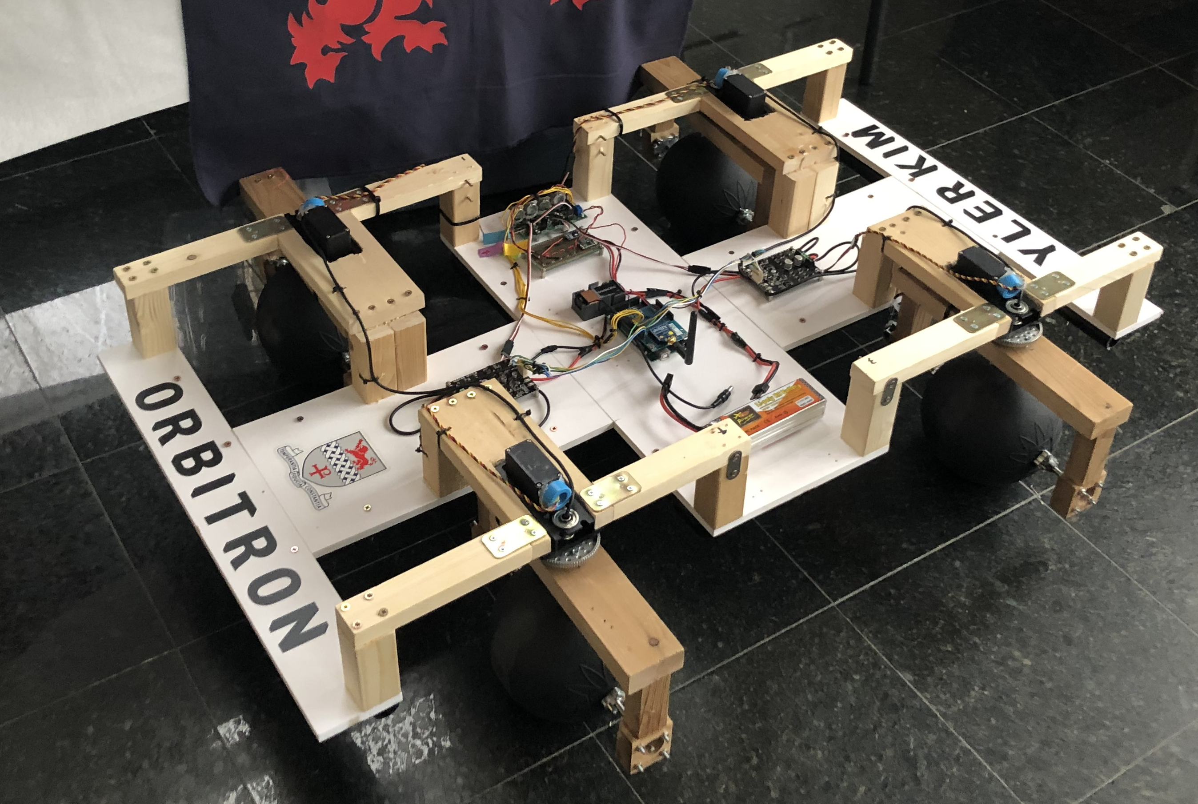
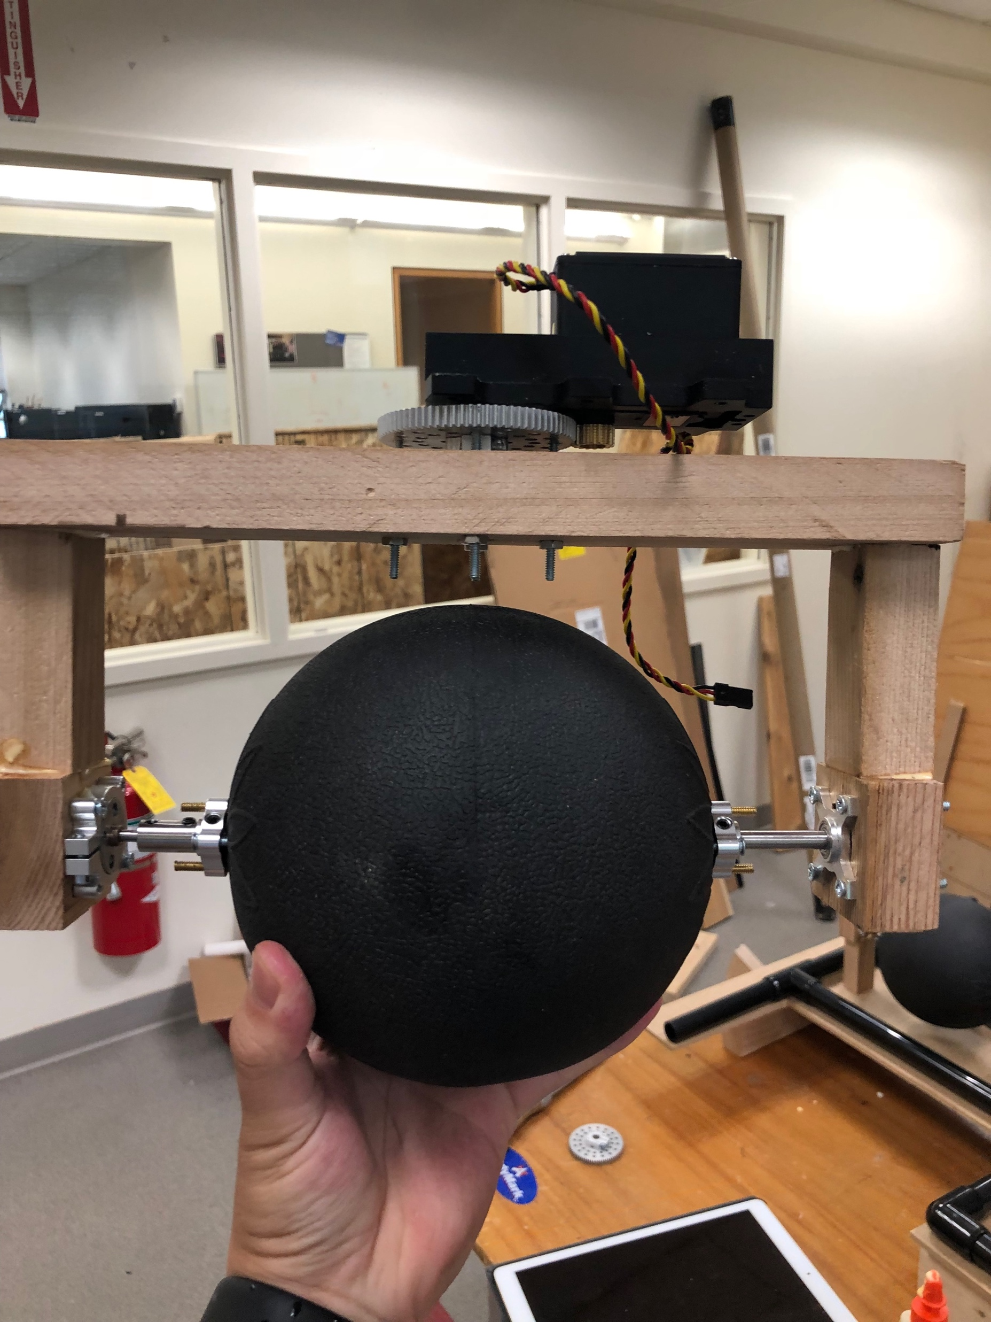
Prototype - Orbitron
Built in Kent School Pre-Engineering Center
2018.03.02 ~ 2018.09.05
Replicates the 4WIS/4WID steering mechanism using a servo motor and a DC motor for each wheel.
TM-785HB Winch Servo
- ”Turns” the wheel
170-RPM Econ Gear Motor
- ”Drives” the wheel
Notes:
Annd.. Here’s the fun part.
As you can see over here, this is the prototype I built in Kent School Pre-Engineering Center since last year. I even gave a cool name “Orbitron”
In fact, I built this prototype without any plans of doing research, and I originally built this to simulate vehicle’s motion when it had a spherical wheel.
Eventually, I ended up focusing on the control part of this steering mechanism and start a research project on finding a way to control 4WIS/4WID intuitively.
Anyways, this prototype replicates the 4WIS/4WID steering mechanism using a servo motor and a DC motor for each wheel.
Below the text you can see the wheel part of the Orbitron. The Winch Servo, a servo that is capable of moving over 700 degrees, is responsible for turning the wheel. And the Gear motor is responsible for driving the wheel.

Slide 12
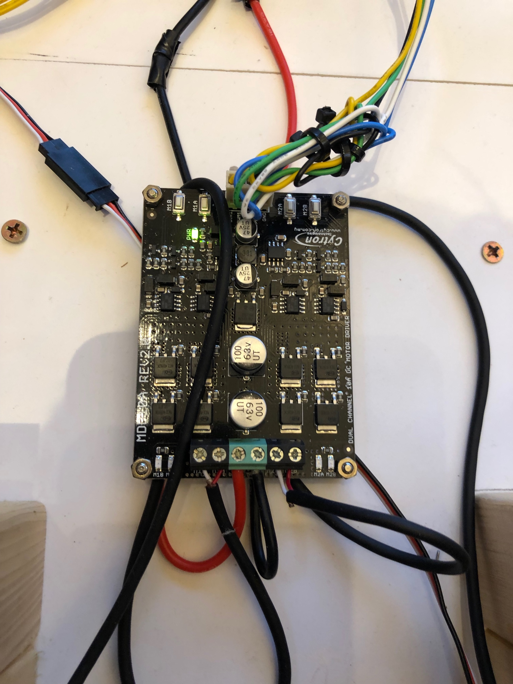
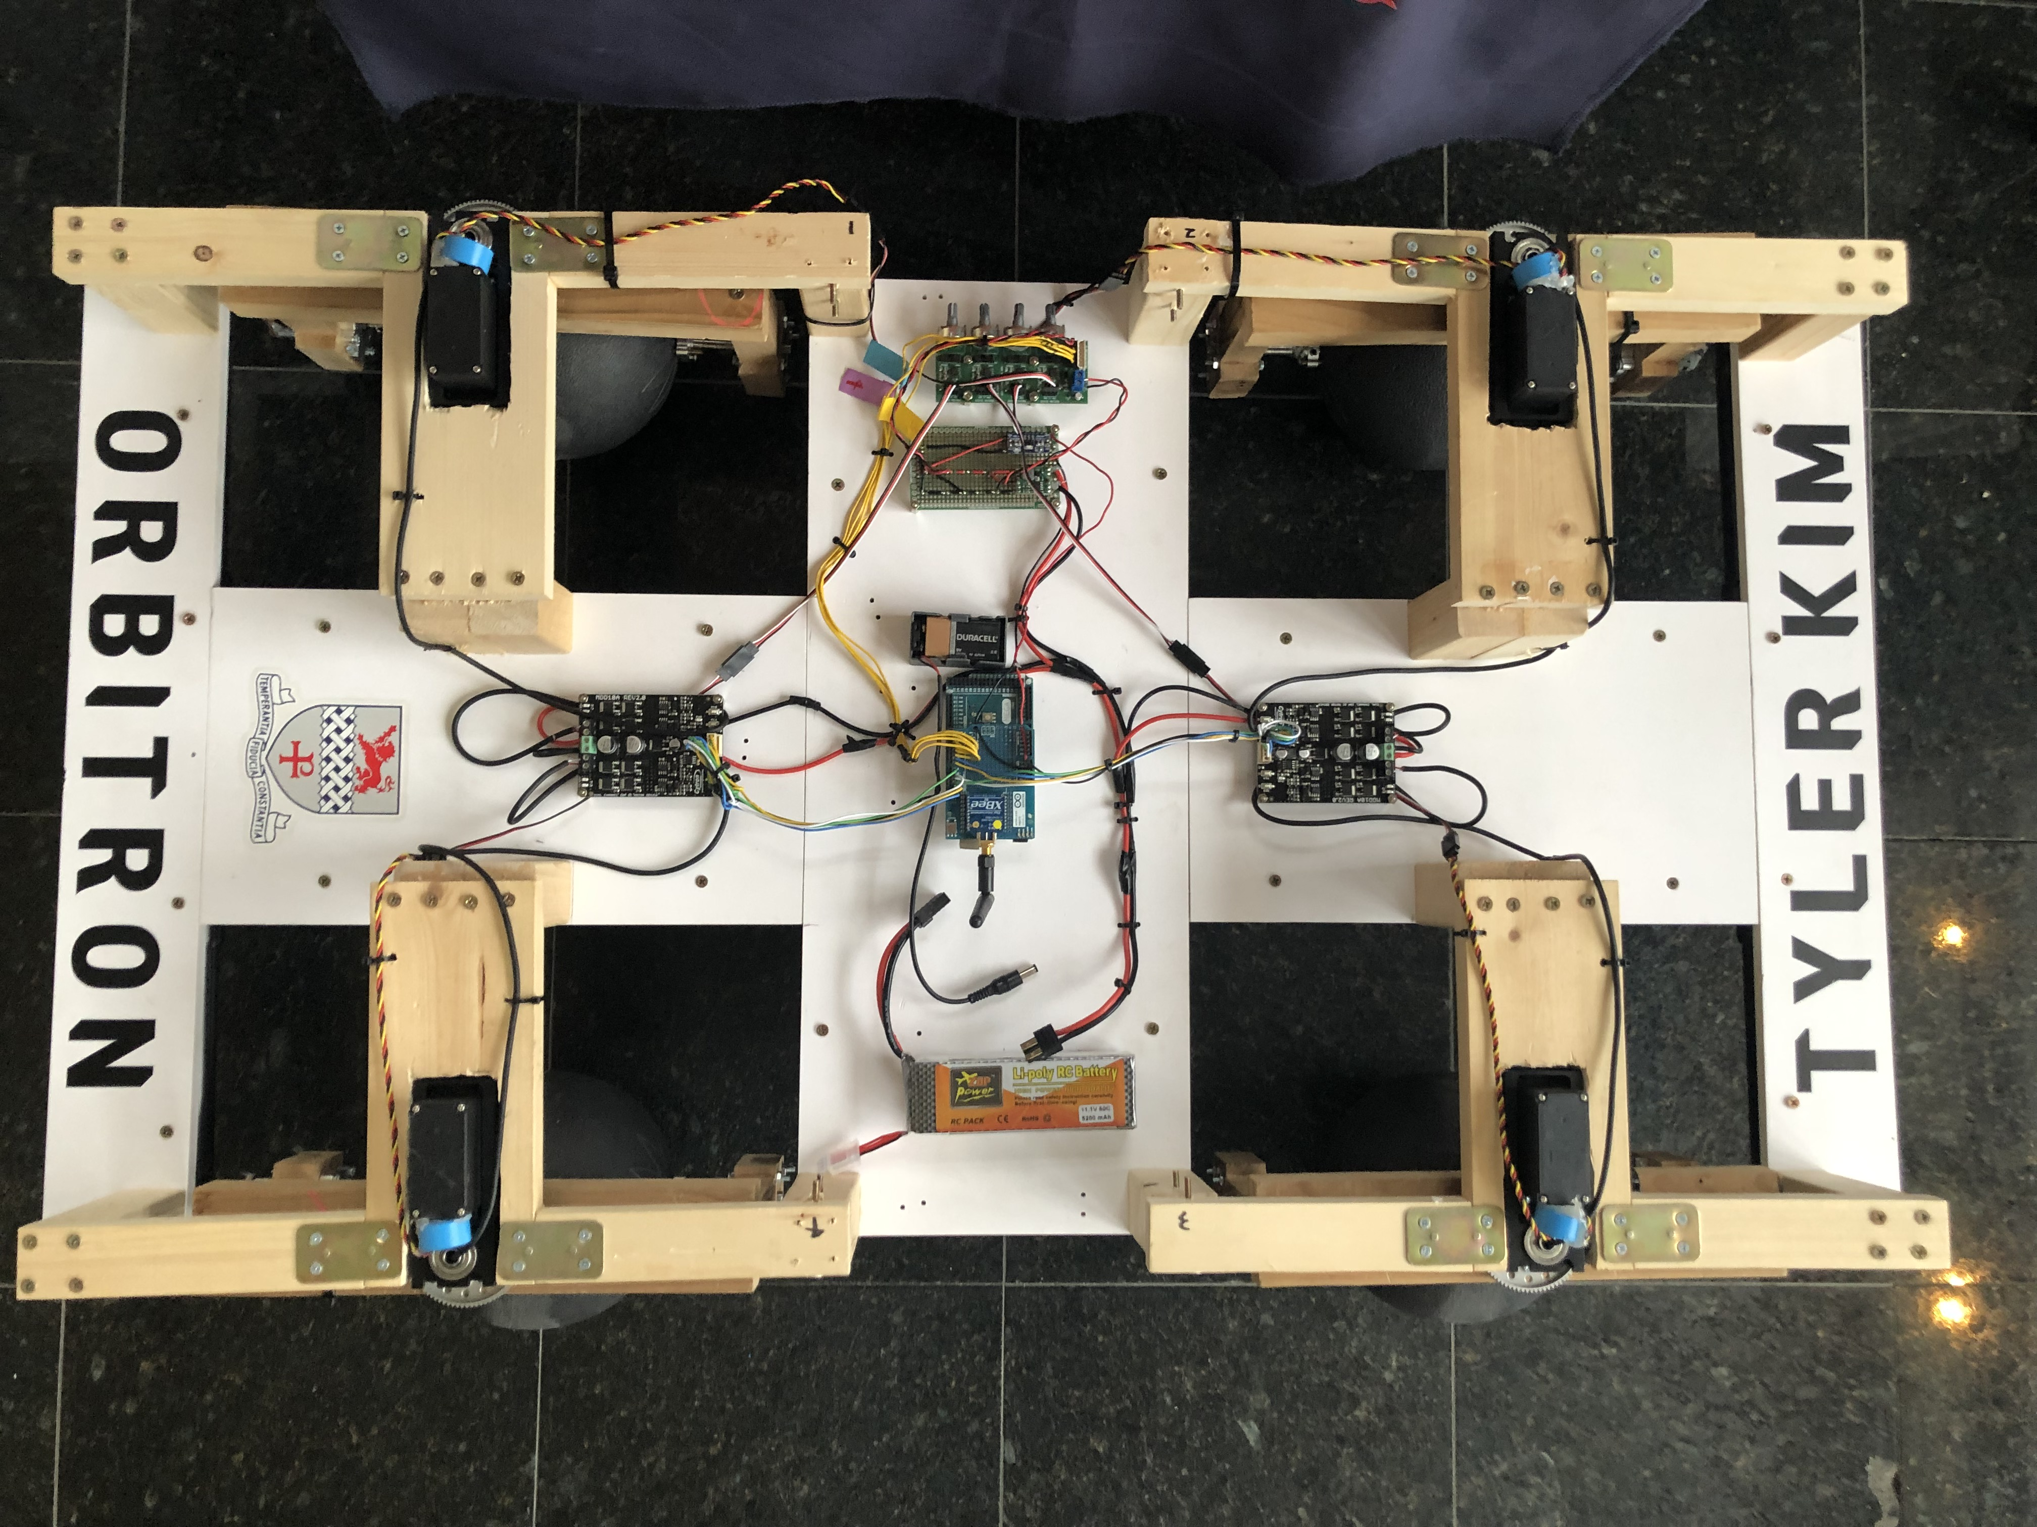
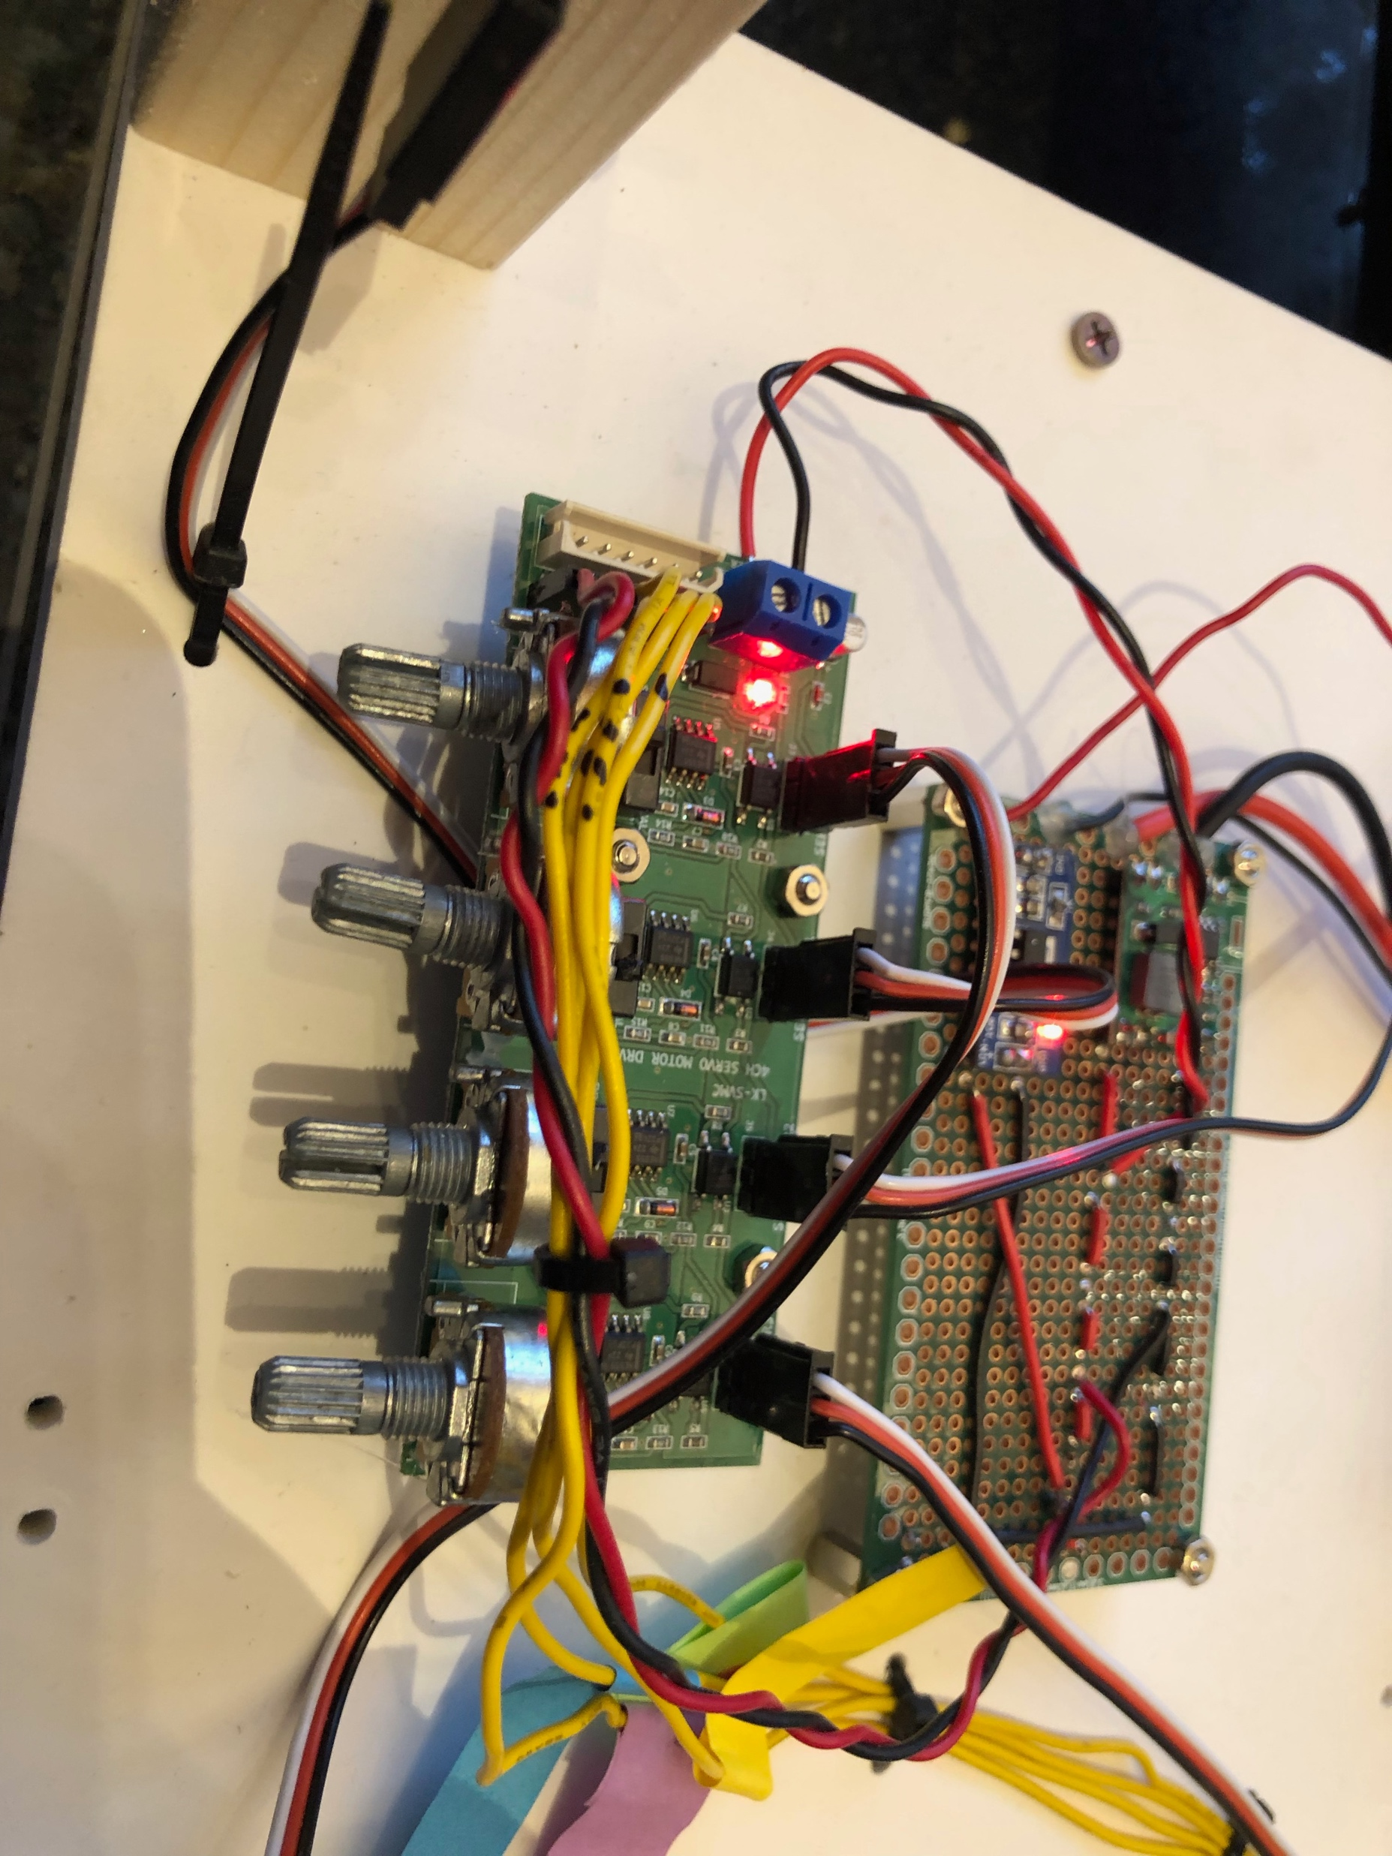
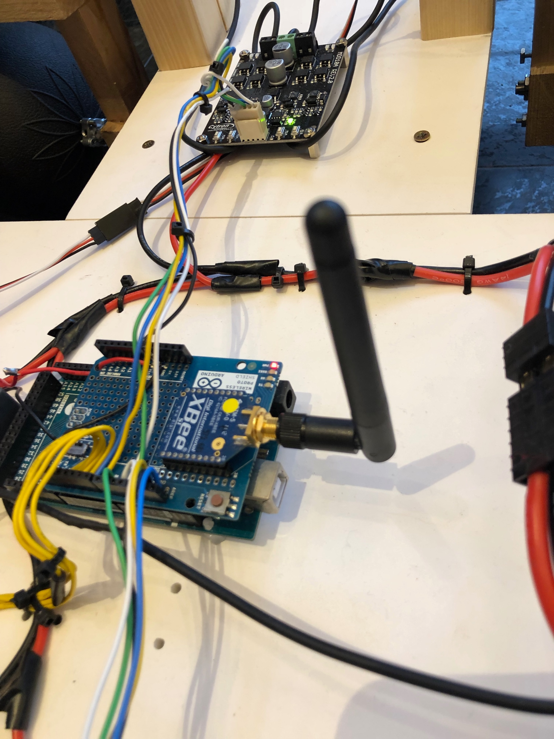
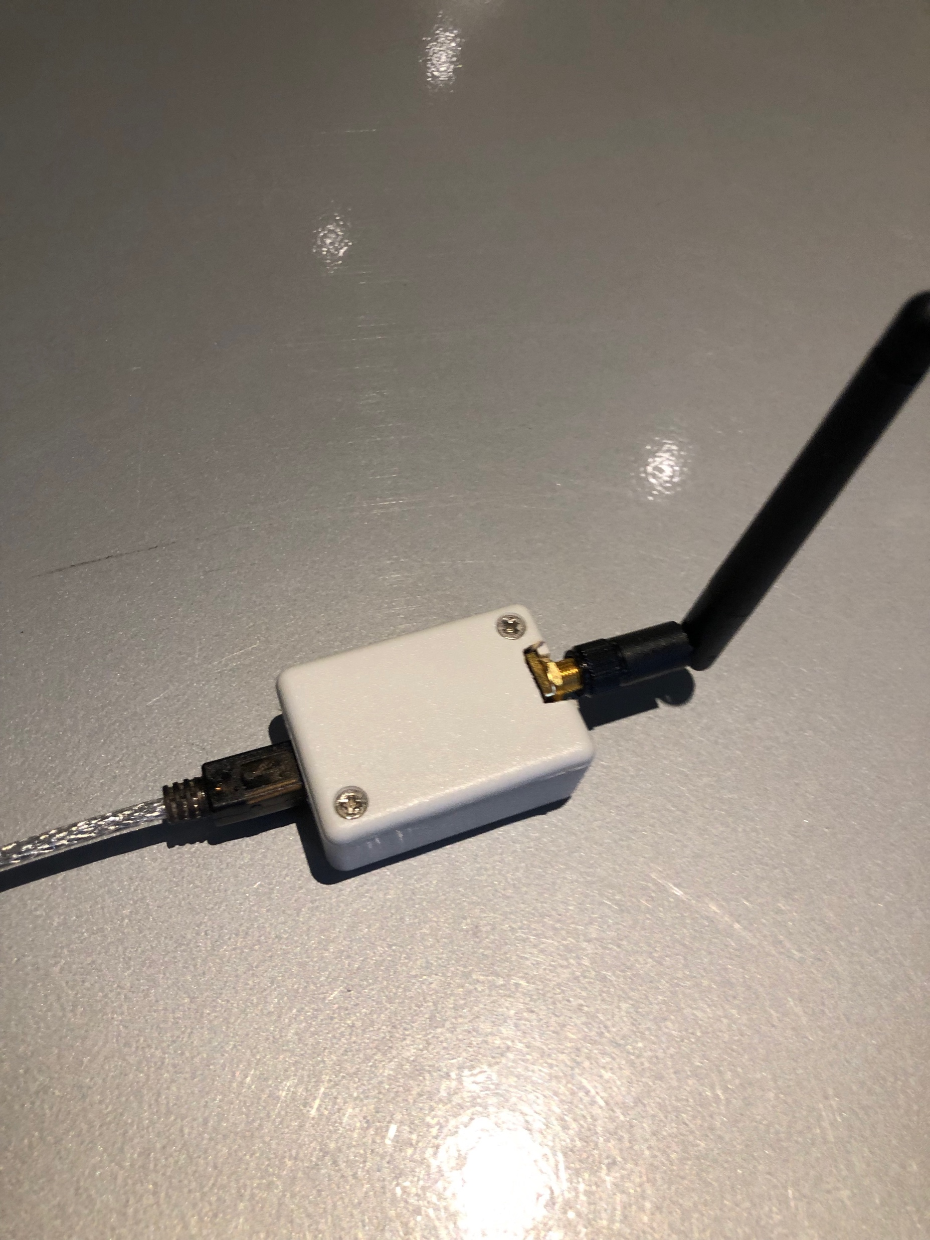
Prototype - Orbitron
Dual Channel DC Motor Driver
Servo Motor Hub
Arduino Mega 2560 Board
Wheels
Xbee Wireless Module
Notes:
Now, I’ll go on more details about the prototype I made.
sorry, I can't drive this tonight.
1. start the thing. it repositions everything to the designated position
2. dc motor driver - that allows me to test the motors.
3. servo motor hub - prototyping
4.

Slide 13
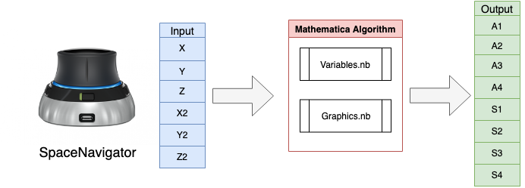
Algorithm Setup
Notes:
Finally, here we are at the algorithm part.
I used Mathematica, a symbolic mathematical computation program, to develop this algorithm. There’s also a similar program called Matlab, but I decided to use Mathematica as I felt more comfortable programming this way.
So here’s the basic setup of the presented algorithm.
As I mentioned before, SpaceNavigator will create a set of six variables ranging from -1 to +1 as we play around with it. These variables are read under Mathematica’s dynamic function, which allows us to read the data real-time.
Now, the algorithm has two different files, Variables notebook and Graphics notebook. The Variables notebook is responsible for translating data from SpaceMouse to the desired eight parameters, and the Graphics notebook is responsible for
Showing the entire process visually so the user can control it more intuitively.
Oh and by the way, fun fact. There are total of 13 pages of code, and only three pages are the actual parts that does all the work. The rest of the code is simply for setting up variables for graphics and displaying it correctly.

Slide 14
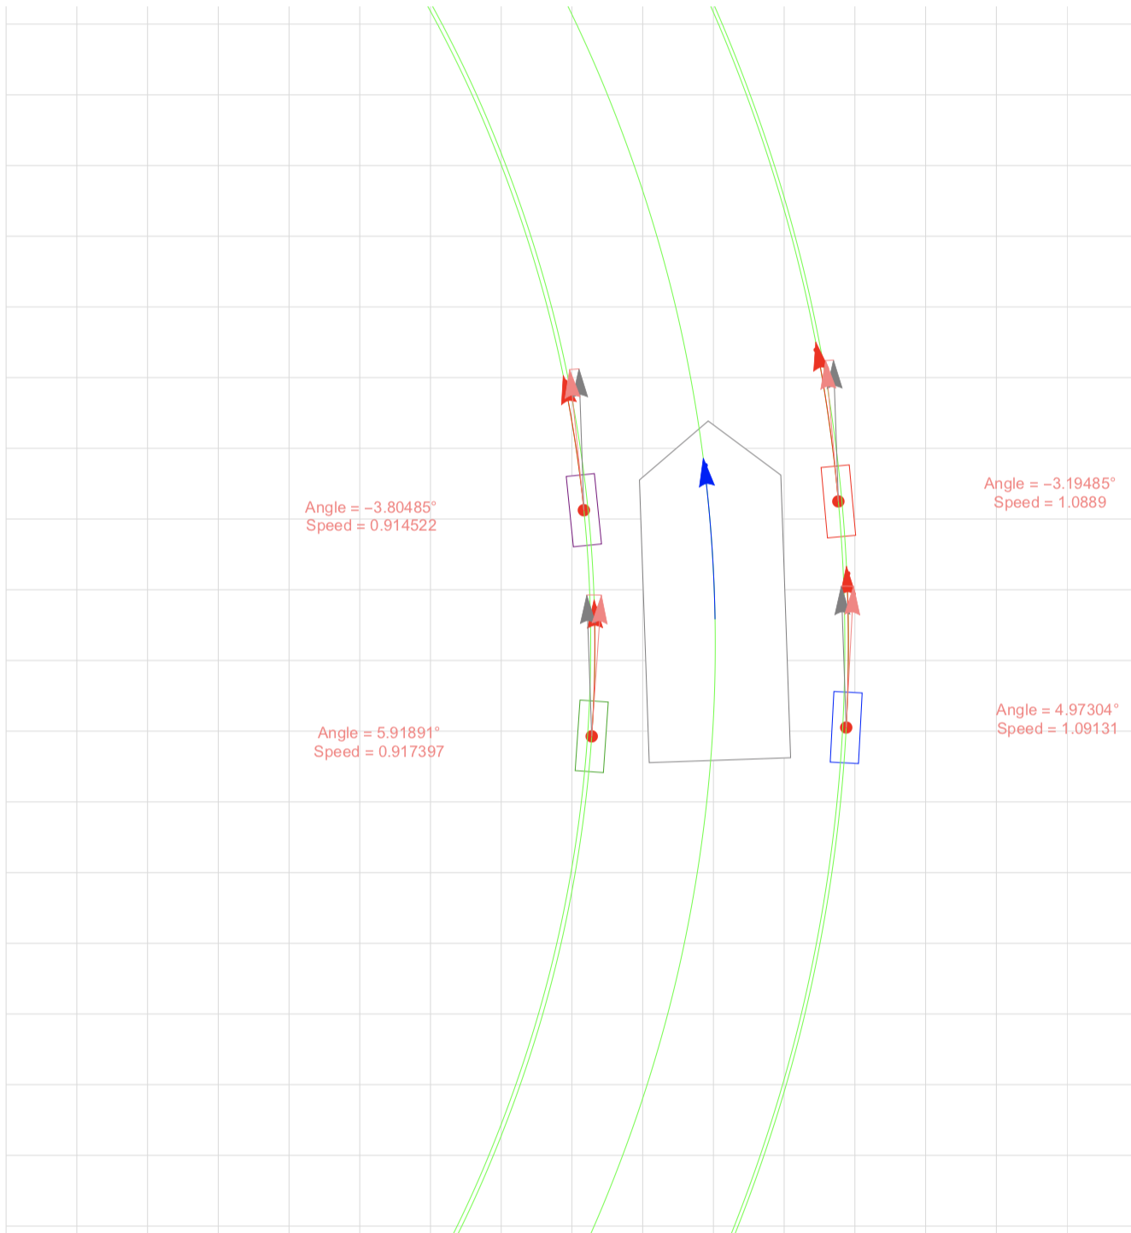
Core Concepts of the Algorithm - 1
Core Concepts
Every motion is a circular motion.
Even straight motion can be considered as a circular motion with an infinite radius of curvature.
Each wheel’s angle and speed always depend on the concentric circles.
How it’s calculated
Direction
Direction of each wheel is simply set to be tangent to each concentric circle.
Speed
Radius of the concentric circle based on vehicle’s center is normalized as 1.
Using concept of linear and angular velocity, we calculate relative speed based on the ratio of concentric circles’ radius.
Notes:
So, how can all of this be computed with three pages of code?
There are two core theories in this algorithm that simplified its development process.
The first core concept is that every motion is considered to be a circular motion. With this concept, there is no need to separate straight motion and curve motion because straight motion can be considered to be a circular motion with an infinite radius of curvature.
The second core concept is that each wheel’s angle and speed always depend on the circles.
Now, this idea will make more sense as I explain about this image.
This is a single diagram that pretty much summarizes everything. This diagram will change in real-time, and it has all the components for understanding where and how the vehicle is going to move.
------READ--------
First of all, all the arrows shown in this interface are color coded differently to distinguish each from others easier, and four labels are shown next to each wheel which displays the updated angle and speed value.
Additionally, there are always five different green circles that each represent the radius of curvature of each wheel and the center of the vehicle. It may look like there are only three concentric circles on the image above, but there are actually five.
This can be applied to vehicles with any number of wheels, since we can simply add more curvature circles.
For the arrows, the blue arrow in the center of the diagram represents the motion of the center of the vehicle. Then there are three arrows in each wheel. The gray arrow is always fixed along the vehicle body’s angle and acts as a base for other two arrows. The pink arrows are the tangent line of the green circle, and the angle between the gray arrow and the pink arrow is used to determine each wheel’s angle. Lastly, the red arrow represents the actual trajectory of the vehicle. As the user controls the vehicle, the length of the red arrow will always represent the relative velocity of each wheel by differing its length.
This is the really short video showing how the interface of this algorithm works when I’m actually controlling with a spacemouse.

Slide 15


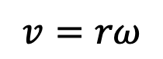
Core Concepts of the Algorithm - 2
How it’s calculated
Direction
Direction of each wheel is simply set to be tangent to each concentric circle.
Speed
Radius of the concentric circle based on vehicle’s center is normalized as 1.
Using concept of linear and angular velocity, we calculate relative speed based on the ratio of concentric circles’ radius.
$$r=radius of curvature$$
$$v=rω$$
$$ω=angular velocity$$
Equation 2 Linear Velocity
Notes:
Now, let me tell you how direction and speed value for each wheel are calculated.
For the angle variables, the wheels’ angle is always tangent to the circle. As I mentioned before, one of the goals for this research is to prevent any conflicts.
This will prevent wheels’ motion to conflict with each other as well as allowing the user to accomplish desired motion easily.
For the speed variables, we’re using a simple concept of linear and angular velocity to calculate the relative speed value.
As shown in equation 2, the linear velocity of each wheel depends on the radius of curvature and the angular velocity.
However, the center motion’s speed is always normalized to 1, which makes angular velocity constant for all circles because they are concentric. This means only the $r$ determines the linear velocity for each wheel, so the wheel’s speed is always a ratio to the center motion’s speed as well as a ratio to the radius of a circle for vehicle’s center. For example, the outer wheels will have a value of lets say 1.01, so they will have to move faster than the vehicle’s center. And the inner wheels will have a value of 0.9 or something so they have to move slower than the vehicle’s center.
After having the relative speed values for each wheel, we are simply going to multiply that ratio to the speed at vehicle’s center so each wheel can drive in mathematically perfect speed.
This greatly simplifies the entire algorithm’s computation since only changing the center point and radius of the curvature circle from SpaceMouse’s values can control the vehicle’s versatile motions.

Slide 16
Steering Modes
2WS
4WIS/4WID
Ackerman Steering
Crab Steering
AFRS
Spinning
The Ackermann steering mechanism is a mechanism that is generally used for four-wheel vehicles.
Crab Steering operate by steering all wheels in the same direction and at the same angle. It allows the vehicle to translate or glide to any direction.
AFRS(Active Front Rear Steering) mechanism involves front and rear wheels turning independently for smaller turning radius and better cornering stability.
Spinning is turning the vehicle’s direction with zero turning radius.
Notes:
Here’s the four steering modes we are going to discuss in this paper.
First one is Ackermann steering, which is commonly used on conventional vehicles. Vehicles are turned by steering the front two wheels.
I mean… it’s a clever steering mechanism except for the fact that ANY vehicle can do this. Are we going to need this in the four wheel independent steering? Definitely not [CLICK].
Here’s the three REAL steering modes we are going to implement.
CRAB Steering: just like a crab, you can glide to any direction.
AFRS stands for Active Front Rear Steering, which involves front and rear wheels turning independently. So it’s very similar with the Ackermann steering except that we can turn the back wheels as well, allowing the vehicle to turn in tighter circles.
And these two are really what we only need

Slide 17
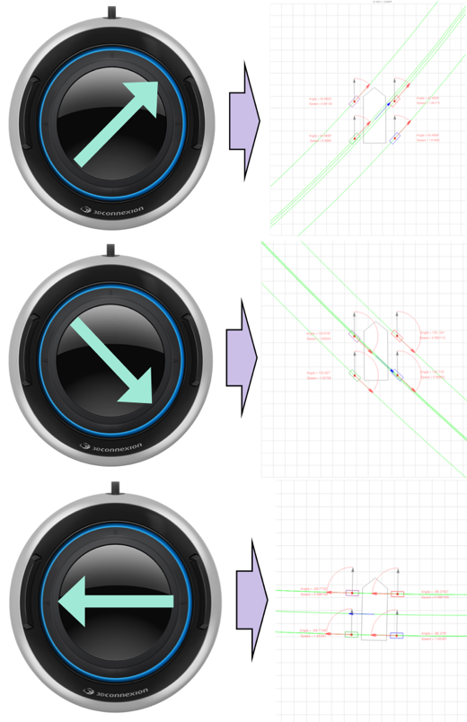
Crab Steering
INPUT
Sliding the mouse
Direction
Speed
All four wheels are angled in the direction the mouse is pointing at.
When only crab steering is being used, speed for all four wheels will be constant.
Notes:
Now I’m going to go over how I implemented each steering mode to this algorithm.
First one is crab steering. This one is the easiest to understand because angle and speed is same for each wheel.
When the mouse is slided along the horizontal plane, all four wheels will be angled to the direction mouse is pointing at.
This is evident on the photo above. When the mouse is slided to top right corner, all four wheels will be angled to point the direction of the mouse.
And for speed, all four wheels will have same same speed when only crab steering mode is used.

Slide 18
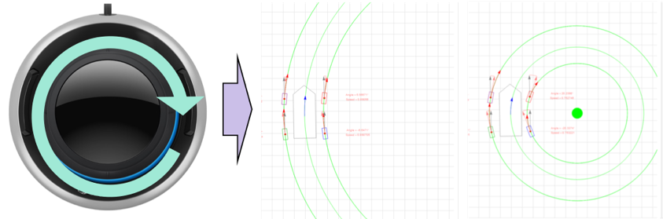
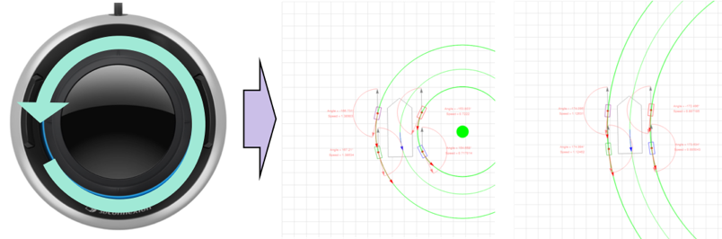


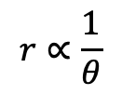
AFRS(Active Front Rear Steering)
$$r∝\frac{1}{θ}$$
$$r=radius of curvature$$
$$θ=twisted angle$$
Equation 3 Radius of Curvature
INPUT
Twisting the mouse
Direction
Speed
All four wheels are set to be tangent to each concentric circle.
Determined as relative speed based on the ratio of concentric circles’ radius.
Notes:
Second steering mode is the most important one, AFRS.
In this part, we are using the twisting motion of the SpaceMouse to change the radius of vehicle’s curvature.
As I mentioned before, the core of our algorithm is that it considers every motion as a circular motion and computes each wheel’s velocity and angle tangent to that circle.
The radius of curvature is calculated by the equation shown above, and theta is controlled with the twisting motion of the mouse.
When the mouse is twisted clockwise, theta is increased, resulting in a larger curvature radius. When the mouse is twisted counterclockwise, theta is decreased, resulting in a smaller curvature radius. Negative theta will make the circle move in the other side of the vehicle.
AFRS is the most important one because this single mode can accomplish both crab steering and spinning.

Slide 19
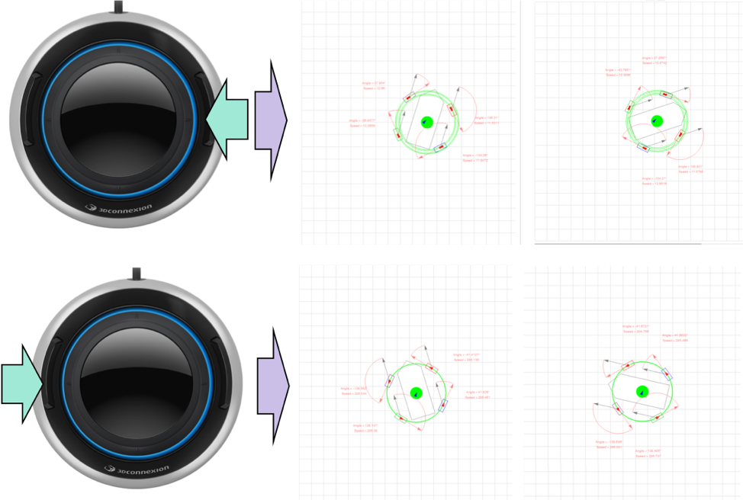
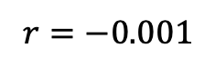
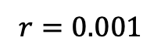
Spinning
INPUT
Pressing the buttons on side of the SpaceMouse
$$r=0.001$$
Center of concentric Circles
Set to be very close to the vehicle’s center
$$r=−0.001$$
Notes:
Lastly, spinning mode. I used the two buttons on the side of the spacemouse to make vehicle spin in respective directions. Pushing right button will make the vehicle spin clockwise, and pushing left will make it go counterclockwise.
So what’s happening here? When we press either of the buttons, the algorithm will move the center of concentric circles very close to the center of the vehicle. It can’t be zero, because that means there are no circles each wheel can refer to.
So depending on which button you press, the algorithm will either set the radius of curvature to 0.001 or -0.001. After that, everything else will work exactly the same as AFRS.

Slide 20
Three Steering Modes
Crab Steering
Radius of Curvature ≈ 10000
AFRS
Spinning
Radius of Curvature ≈ 0.001
Notes:
Now, here’s the diagram that shows why AFRS is the most important one.
Remember how AFRS involves the twisting motion to change the radius of vehicle’s curvature.
Crab Steering
Remember that the core concept here is considering straight motion as curved motion. We can accomplish by continue twisting the mouse to make radius of curvature very large.
Spinning
This is basically AFRS with a very small radius of curvature. We can continueously twist the mouse to make radius of curvature very small, and it will be the same thing as pushing the side buttons.
However, I added these button features so user can easily change the vehicle’s facing direction.
By looking at this diagram, you can see that they are all connected. In fact, I programmed in a way that does not separate different steering modes, and they are always used together to perform fluent movements.

Slide 21
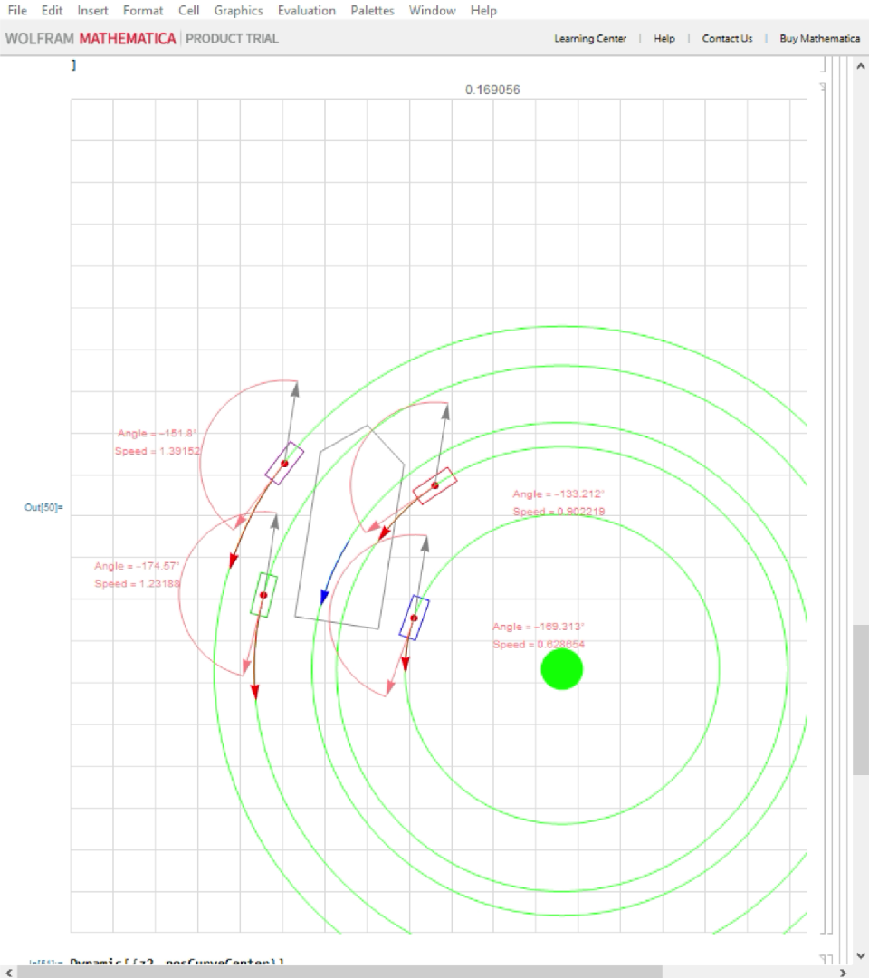
Video from the Algorithm
Notes:
This is a short video ciip I took from my mathematica.
[START VIDEO]
As you can see, crab steering and AFRS are always used together to perform versatile movements.

Slide 22
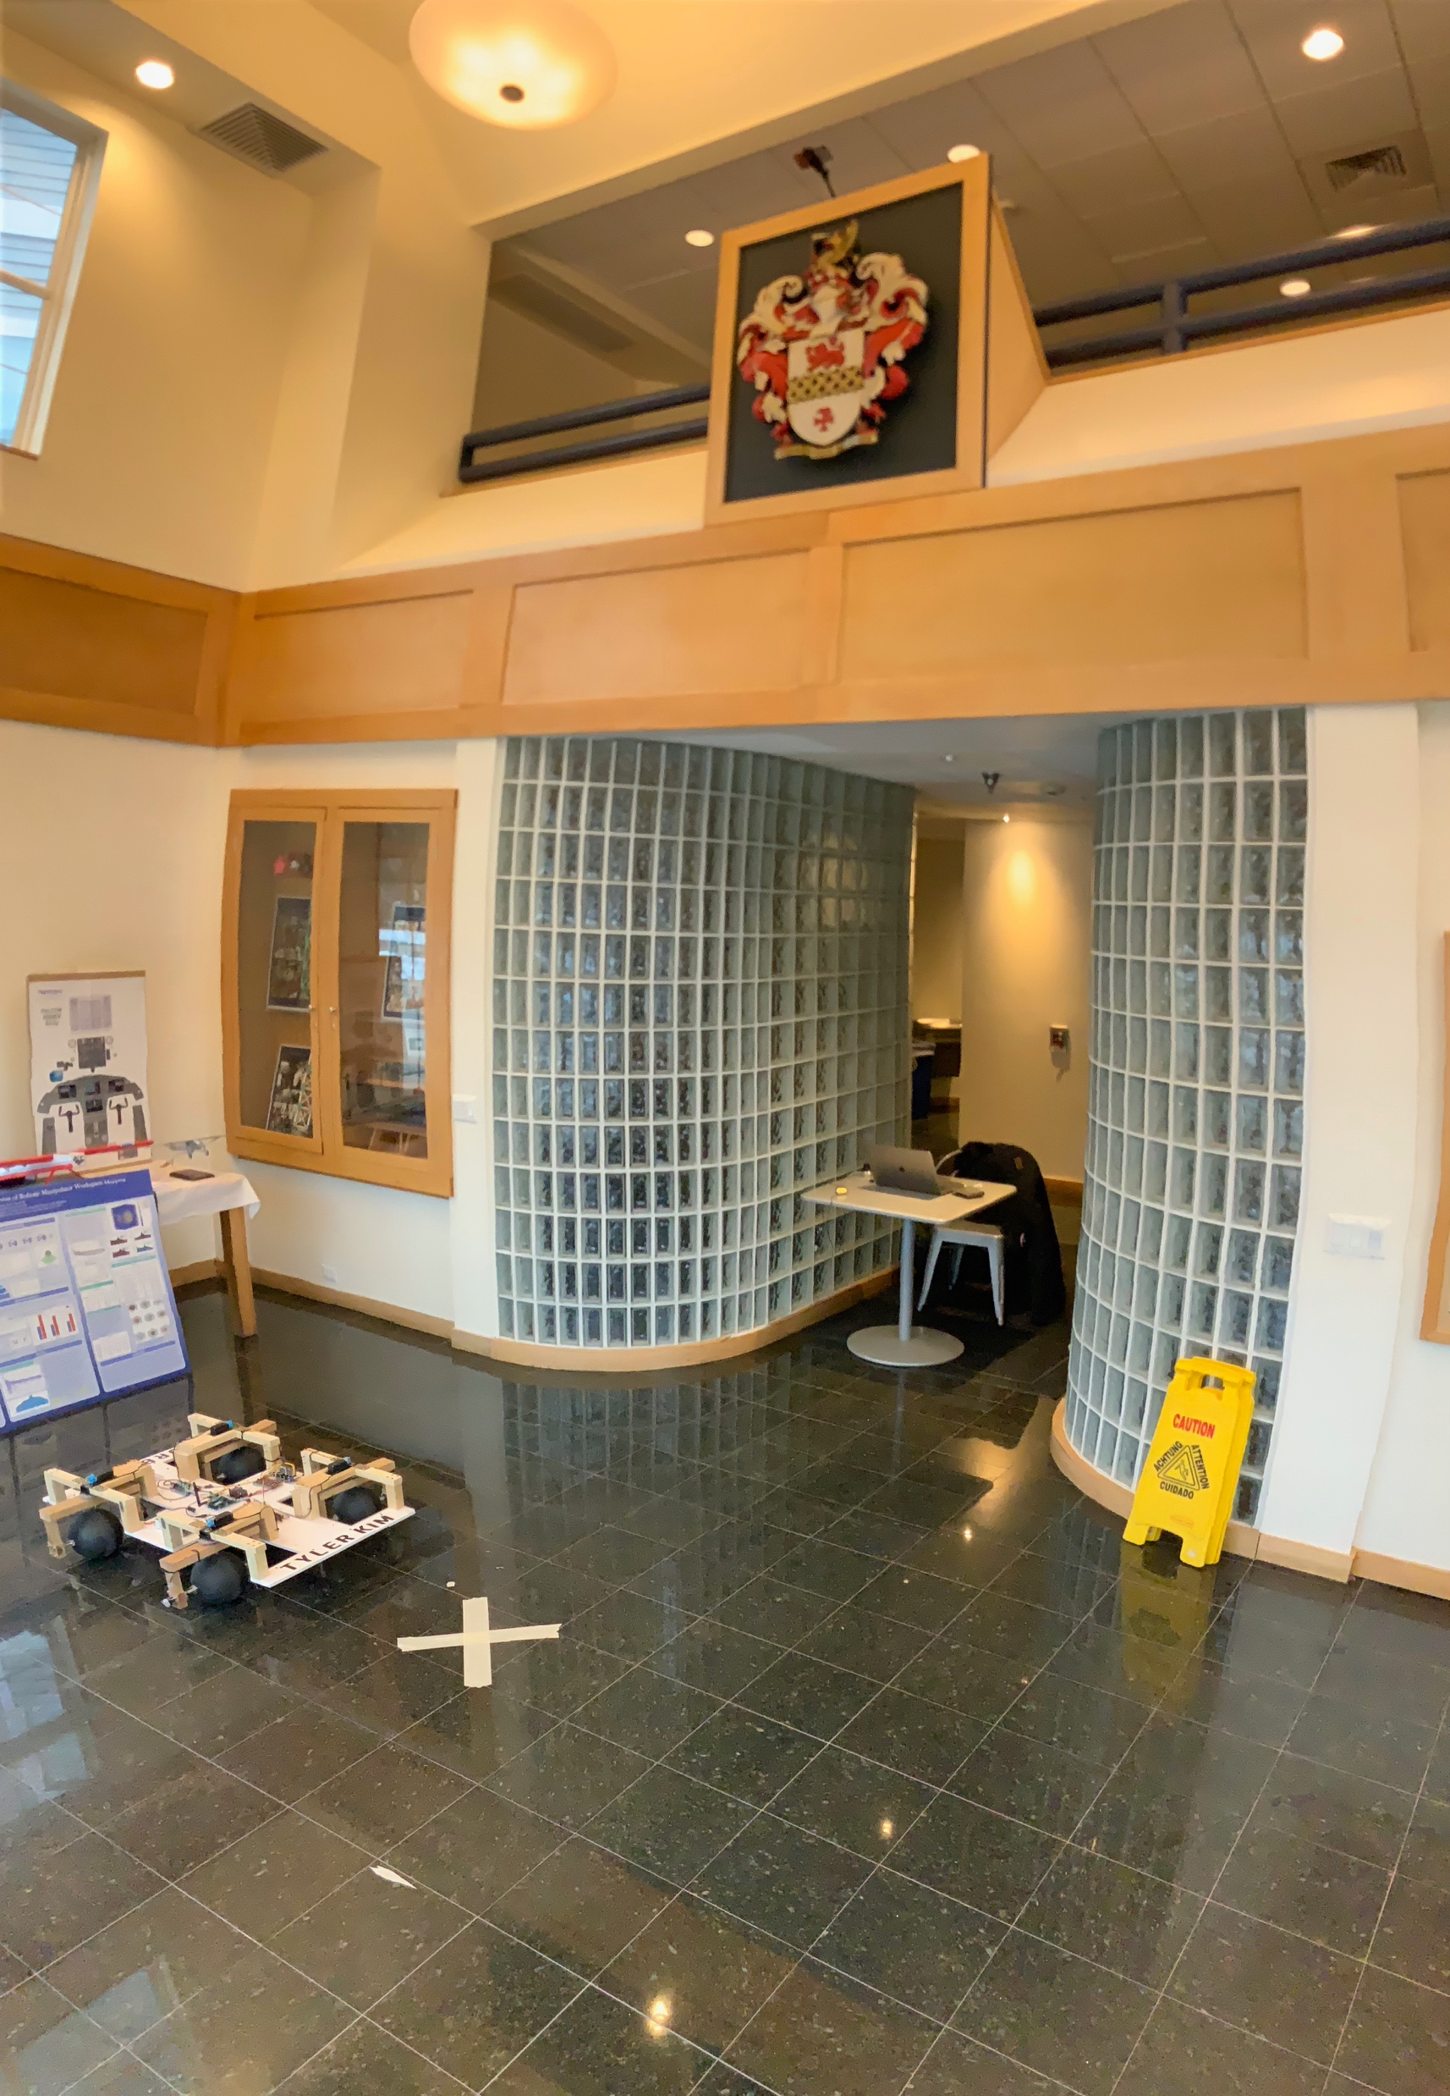
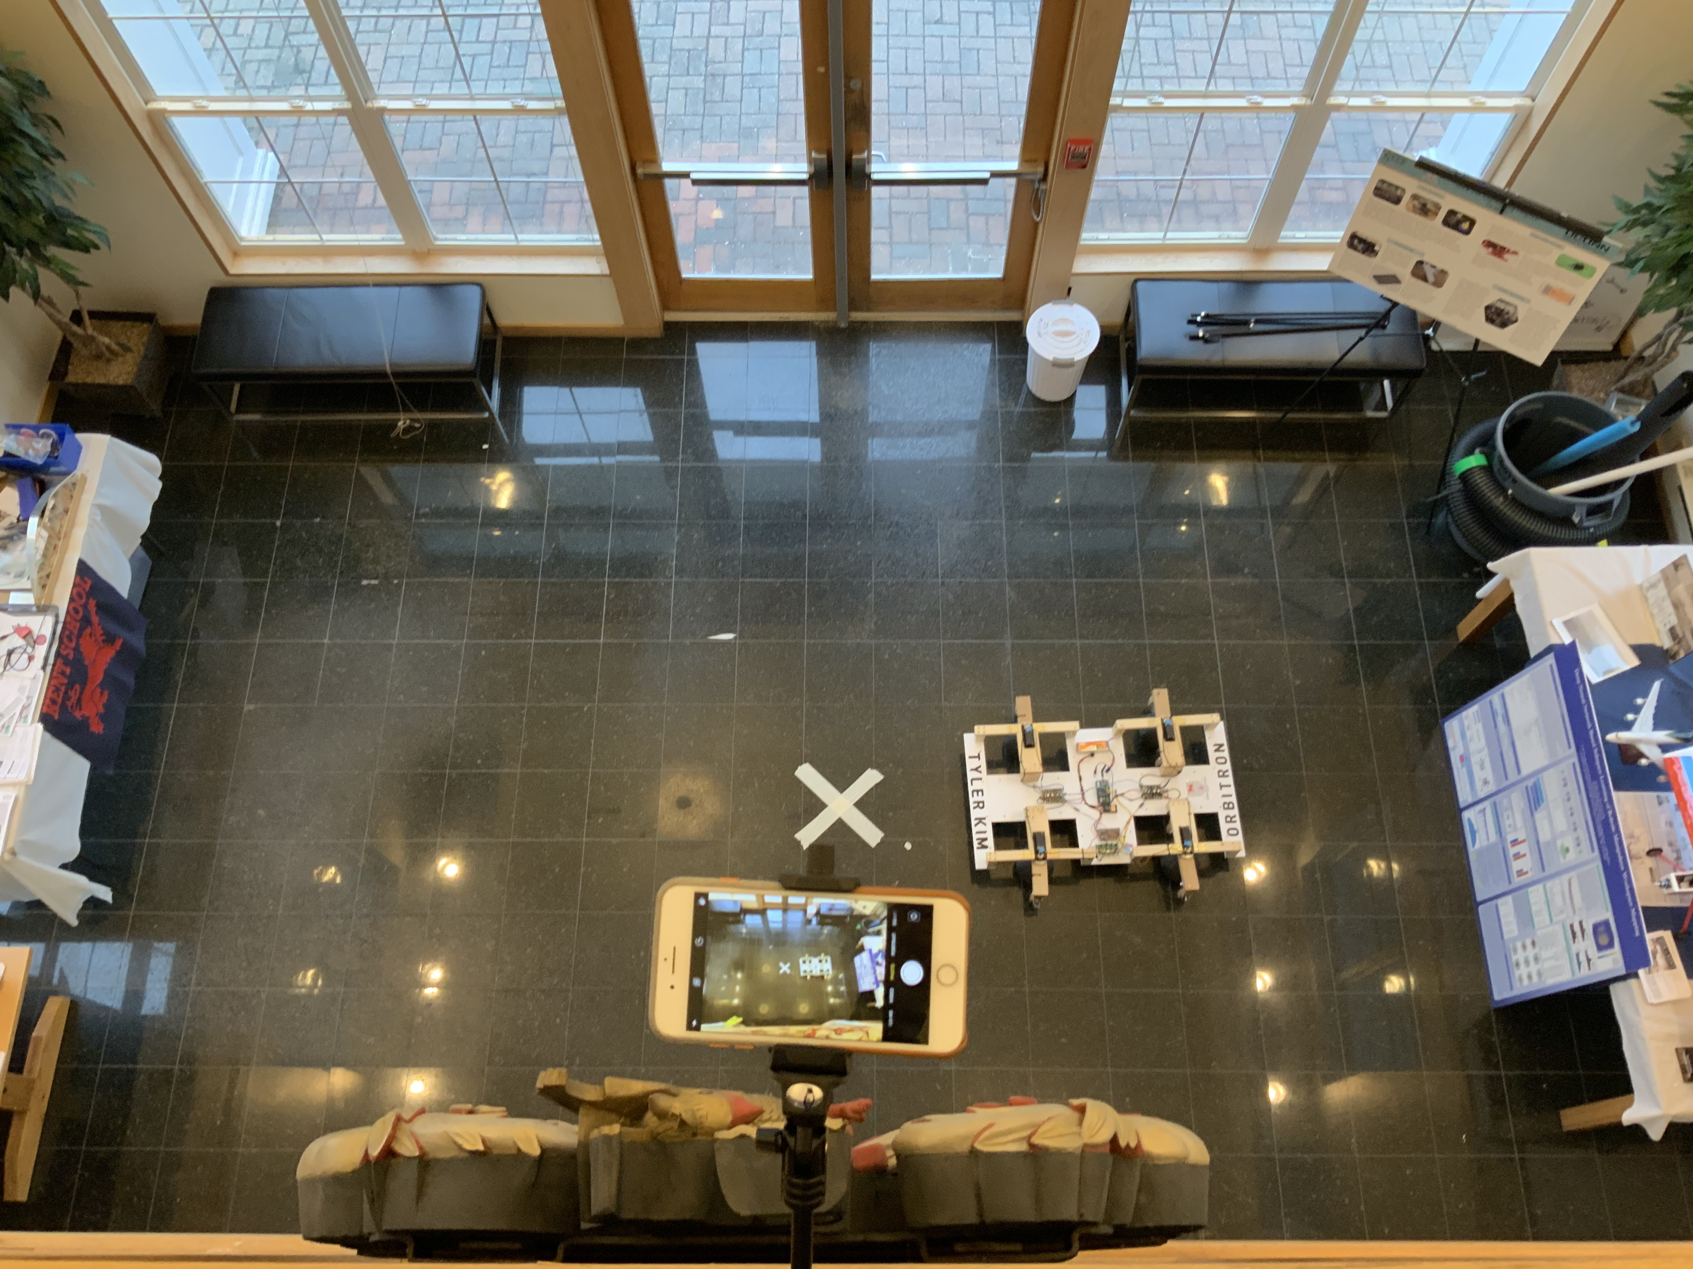
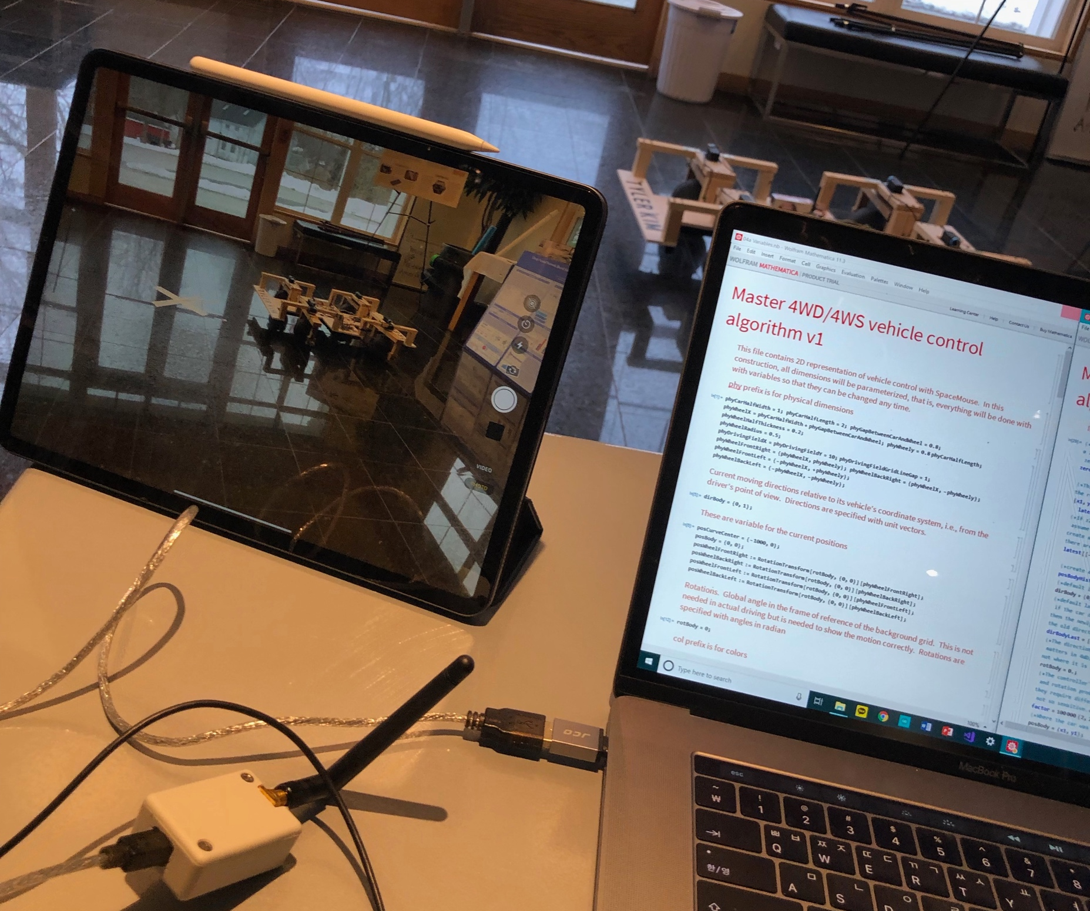
Experiment Setup
Physical experiment was done in Pre-Engineering center’s lobby to test the accuracy of the algorithm
2019.03.02 ~ 2018.03.03
Two cameras, iPhone from above and iPad on the table, keeps track of the vehicle’s motion.
After getting the footage of the vehicle’s motion, it was compared with the algorithm’s motion.
Notes:
Physical experiment was done in Pre-Engineering center’s lobby to test the accuracy of the algorithm
2019.03.02 ~ 2018.03.03
Two cameras, iPhone from above and iPad on the table, keeps track of the vehicle’s motion.
After getting the footage of the vehicle’s motion, it was compared with the algorithm’s motion.

Slide 23
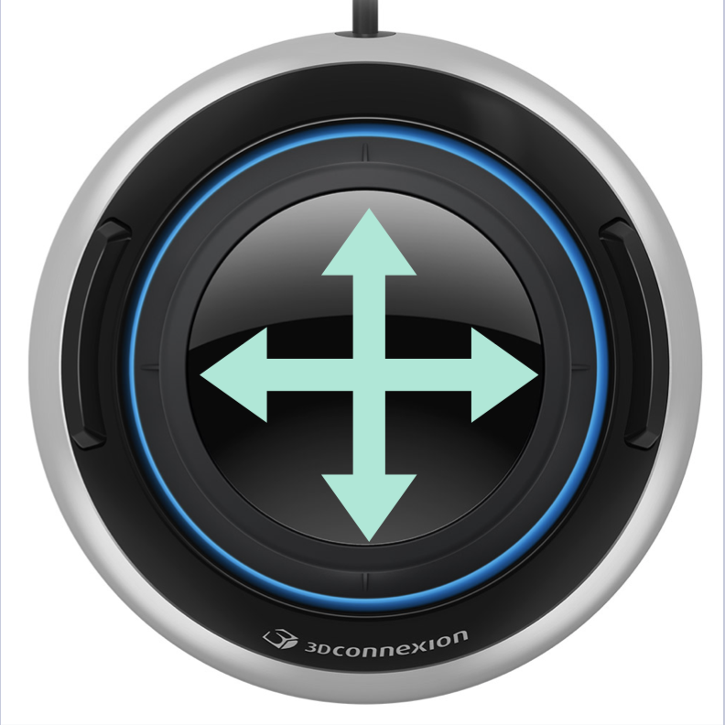
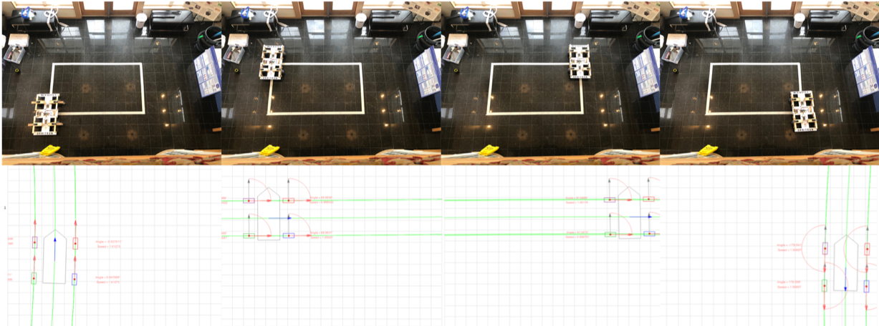
Rectangular Path
Crab Steering
Notes:
The first experiment I conducted was implementing crab-steering to the prototype I built.
On the right, you can see a sequence of photos took with an iphone above, and a sequence of screenshots from the algorithm.

Slide 24
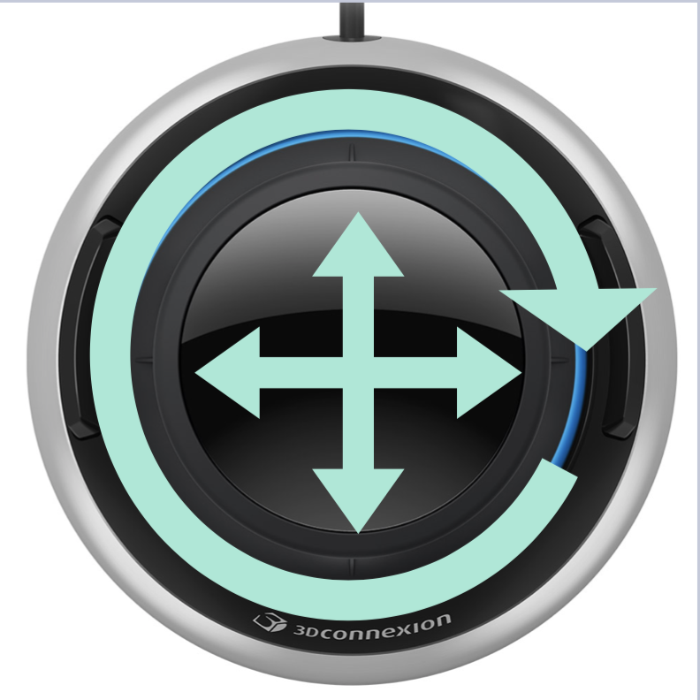
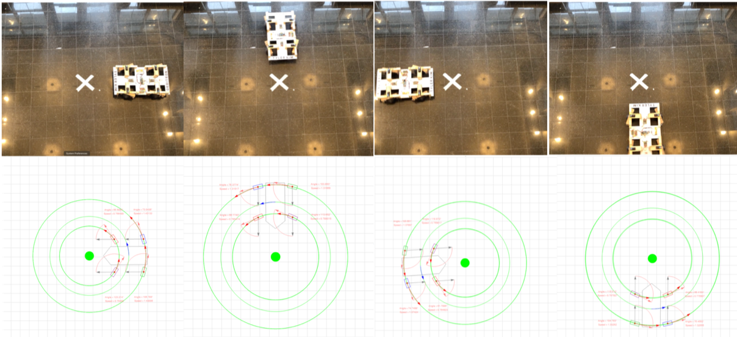
Circular Path
Crab Steering
+
AFRS

Slide 25
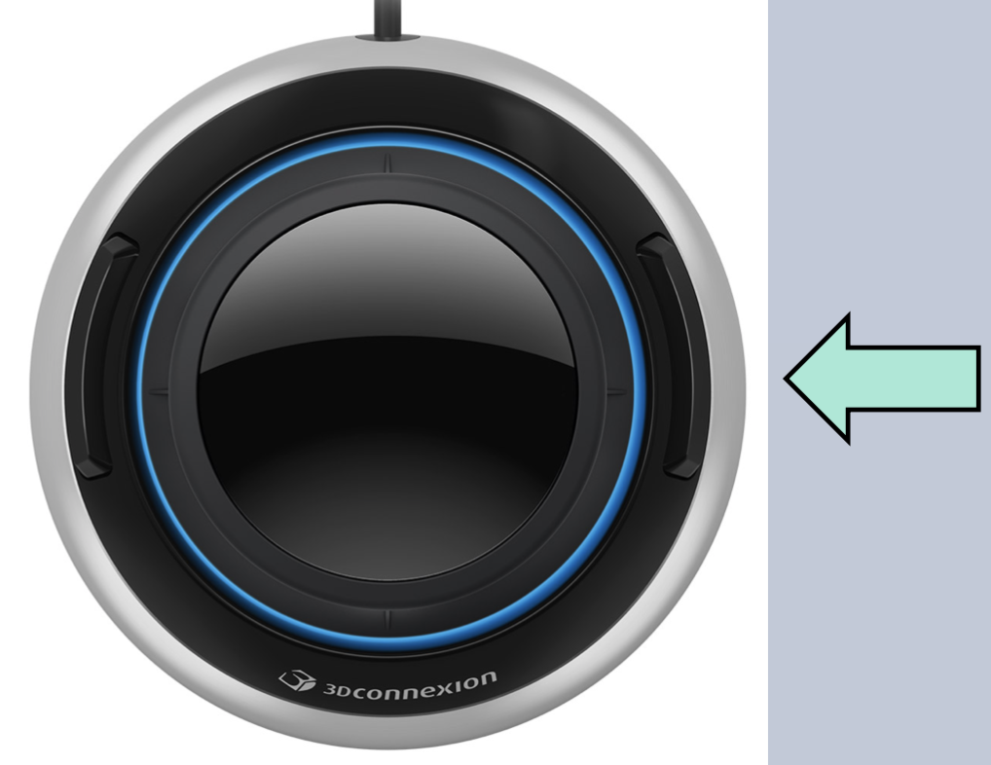
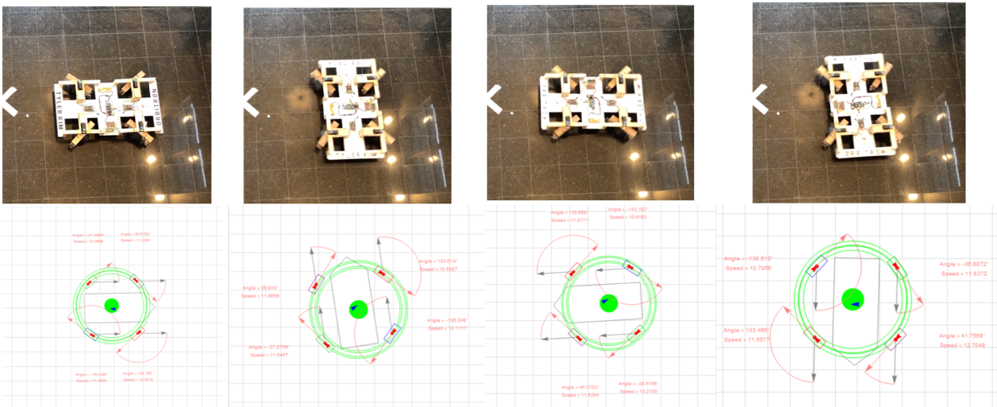
Spinning
Spinning

Slide 26
Conclusion – Okay, so WHY is this significant?
Very intuitive: Slide n Twist!
Possible with any number of wheels
Lowers the boundary of 4WIS/4WID
One of the reasons why 4WIS/4WID is not common is because of the complex way to control.
i.e. Electric Wheelchair
i.e. Search & Rescue robots
Notes:
Talk about motivations as well

Slide 27
How can I extend this project?
What if we consider all motions are..
Spherical?
Notes:
[FIRST CLICK] = What if we consider all motions are spherical?
[SECOND CLICK] = Diagram.

Slide 28

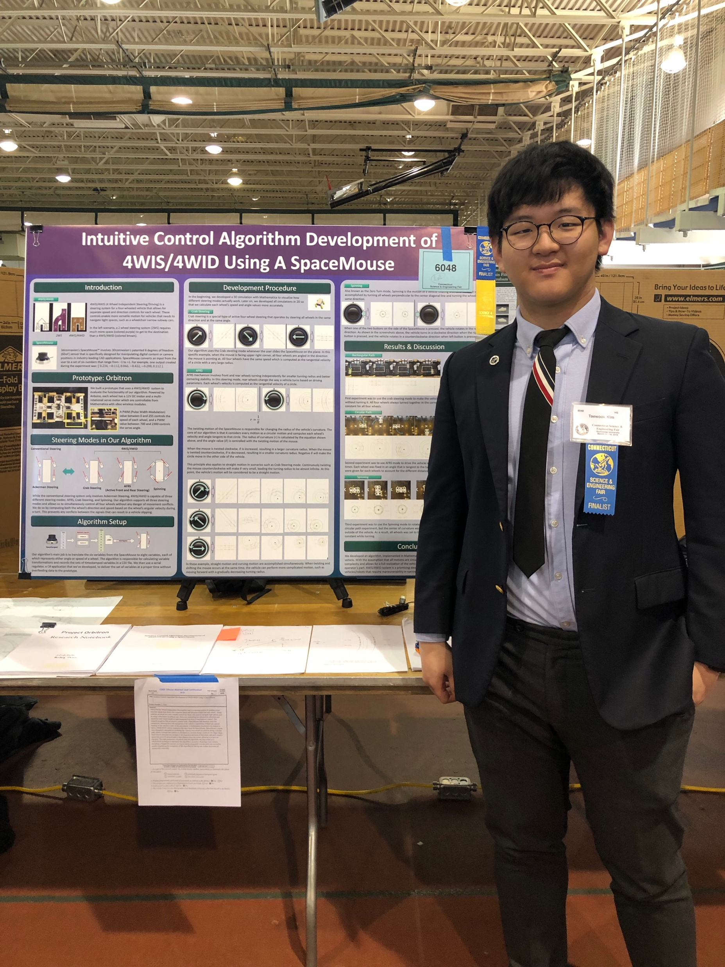
So far…
Connecticut Science and Engineering Fair
Awards
Presented the work on the 71st Annual Connecticut Science and Engineering Fair over spring break
Lockheed Martin Physical Sciences Awards, CSEF March 2019
Computer Science Awards, CSEF March 2019
Collins Aerospace Engineering Awards, CSEF March 2019
United Technologies Corporation Awards, CSEF March 2019
IEEE Awards, Connecticut Section, CSEF March 2019
Robotics And Beyond --- For Excellence in Engineering Design, CSEF March 2019
Barker Mohandas Awards for Transportation Research, CSEF March 2019
Patent Application
Currently in progress of filing a patent application in Korea.
(Expecting initial feedbacks mid-August)
Notes:
Little bragsheet.

Slide 29
Future Plans
1
Currently finalizing paper to apply for Korean conferences.
2
Submit to junior science journals(ex. The Columbia Junior Journal)
Planning to format the paper for each journals during this summer.
3
Extend the project!
“What if we consider all motions were…Spherical?”
Attend International/Korean Conferences on vehicle control

Slide 30
Acknowledgement
Dr. Nadire
Director of the Pre-Engineering Department
My AP Calculus BC teacher.
Guild Paper Advisor
Mr. Saxton
Director of the Mathematics Department
My AP Computer Science A teacher
Notes:
Now, before I end my presentation, I would like to recognize some of the people who made this project possible.
Dr. Nadire is a director of pre-e, calc, blah blah.
- I would like to thank Dr. Ben Nadire for his guidance and support throughout the entire research process. As the director of Kent School’s Pre-Engineering Department, he also provided the workspace to build the prototype vehicle Orbitron and provided access to the Pre-Engineering Center to conduct experiments and collect data.
One of the reasons I chose Kent School was its pre-engineering programs, and I wanted to take advantage of every opportunity Kent gave. Dr. Nadire guided me through the process of getting the pre-e certificate, and this project was also part of my journey to become involved in Kent’s pre-engineering programs.
Mr. Saxton is a..
I would like to thank Mr. Saxton for his AP computer science class and proofreading the report.
Coding: Before & After
Personally, I’ve never written a research report before. he also helped me proofread the report and make comments. Getting comments from someone who knows well in computer science was very valuable to me.
This project would have not been possible without all my friends and teachers who helped me.
Lastly, there is one more person I would like to recognize today.
I notice some of my Korean friends in the audience, and I’m confident that they all know what day today is.

Slide 31

In Memory Of
🎗️
Dong Min Lee
1997 - 2014
Notes:
Five years ago from today, April 16th 2019, there was a largest tragedy in South Korea: The Sewol Ferry Tragedy.
On the morning of April 16th 2014, the South Korean Ferry Sewol sank while carrying 476 people, who were mostly junior students from Dan won High school, who were heading to their school trip to Jeju Island.
Although 172 passengers were rescued by fishing boats and other commercial vessels, 304 passengers and crew members sunk into the deep sea with the ferry.
This incident was the single most shocking news to South Korea not only because of the scale of the tragedy, but also because of so much other corruptions and inhumane actions involved in this accident.
Even after 5 years, there was a massive memorial march in front of the Seoul City hall yesterday, with everyone holding the yellow ribbon which symbolizes our duty to remember the Sewol Ferry Tragedy.
Now, there’s more specific reason why I chose this date to present my guild paper.
One of those 304 passengers who sunk with the Ferry was one of the friend I am glad that I met him in my life, Dong Min Lee.
[ANIMATION]
I first met him in an engineering summer camp in 2012, and we were in the same robotics team to compete with others.
Being three years older than me, he was a great leader who drove our robotics team to victory, but he was also a great mentor who could answer any questions regarding my dreams in engineering.
Eventually, Dong Min was the one who brought me into the world of engineering and coding, and I quickly fell in love with these fields.
To be honest, I ended up just like Dong Min I saw in 2012, someone who loves building crazy stuff and working on his own research. And I am so glad that I fell in love with engineering that early.
And really, I don’t think I would’ve come this far without Dong Min. In fact, the whole Orbitron project derived from a conversation I had with Dongmin about possibilities of using spherical wheels in vehicles.
Therefore, I would like to thank Dong Min for being a great friend, mentor, and a leader.
Following all these acknowledgements, now I would like to close my presentation, “Intuitive Control Algorithm Development of 4WIS/4WID Using a SpaceMouse”, in memory of Dong Min Lee.
[CLICK] Thank you.

Slide 32

Thank you

Slide 33
Q & A

